Slide 1
Smoking, and Lung Cancer?
By Ben Beyer, Elliot Rippe, and Sam Appleton

Slide 2
Problem
Analyze the relation between smoking and the development of lung cancer
1R, Naive Bayes, J48

Slide 3
Set Up
Data split-
All training/testing
66%-34% split
50%-50% split
10-fold cross validation

Slide 4
Data
187,109 instances
9 attributes
Target class: death codes
0: alive
1: death from other causes
2: lung cancer death

Slide 5
Attributes
Age: Age on January 1, 1982.
Gender: 0=Male, 1=Female
Education: 0=no college, 1=some college
Smoker: 1=never, 2=former, 3=current
Cigarettes/day: Values rounded UP to the nearest 5.
Years smoked: Number of years smoked as of January 1, 1982.
Years quit: Number of years since smoking cessation, as of
January 1, 1982 (zero indicates less than one year)
Follow Up Time: Years from January 1, 1982 until death or last
interview.
Death codes: 0=alive, 1=death from other causes, 2=lung cancer death.
Freq: The frequency at which each combination of variables occured.

Slide 6
Data Set
Data set initially split up into 7 smaller arff files:
never-smokers
current smokers: male
current smokers: female
former smokers: male, no college
former smokers: male, some college
former smokers: female, no college
former smokers: female, some college
(0.071%)
(11.98%)
(10.91%)
(20.57%)
(26.65%)
(12.52%)
(16.63%)

Slide 7
OneR
Followup_Time: 177,920/187,109 instances correct
< 0.5 -> 0 (alive)
< 5.5 -> 1 (death from other causes)
>= 5.5 -> 0 (alive)
10-Fold Cross Validation:
Correctly Classified Instances 95.089 %
Incorrectly Classified Instances 4.911 %
a b c <-- classified as
159936 36 0 | a = 0
4931 17984 0 | b = 1
965 3257 0 | c = 2
Use Training Set:
Correctly Classified Instances 95.089 %
Incorrectly Classified Instances 4.911 %
a b c <-- classified as
159936 36 0 | a = 0
4931 17984 0 | b = 1
965 3257 0 | c = 2
66%-34% split:
Correctly Classified Instances 95.0296 %
Incorrectly Classified Instances 4.9704 %
a b c <-- classified as
54378 11 0 | a = 0
1670 6077 0 | b = 1
340 1141 0 | c = 2
50%-50% split:
Correctly Classified Instances 94.9954 %
Incorrectly Classified Instances 5.0046 %
a b c <-- classified as
79893 18 0 | a = 0
2481 8979 0 | b = 1
512 1671 0 | c = 2

Slide 8
Naive Bayes
10-Fold Cross Validation:
Correctly Classified Instances 86.1519 %
Incorrectly Classified Instances 13.8481 %
a b c <-- classified as
142973 16800 199 | a = 0
4670 18200 45 | b = 1
601 3596 25 | c = 2
Use Training Set:
Correctly Classified Instances 85.8874 %
Incorrectly Classified Instances 14.1126 %
a b c <-- classified as
142376 17378 218 | a = 0
4563 18301 51 | b = 1
581 3615 26 | c = 2
66%-34% split:
Correctly Classified Instances 86.8573 %
Incorrectly Classified Instances 13.1427 %
a b c <-- classified as
49267 5064 58 | a = 0
1751 5982 14 | b = 1
237 1237 7 | c = 2
50%-50% split:
Correctly Classified Instances 87.3667 %
Incorrectly Classified Instances 12.6333 %
a b c <-- classified as
73026 6815 70 | a = 0
2739 8697 24 | b = 1
380 1791 12 | c = 2

Slide 9
J48
10-Fold Cross Validation:
Correctly Classified Instances 95.5726 %
Incorrectly Classified Instances 4.4274 %
a b c <-- classified as
159612 317 43 | a = 0
3921 18911 83 | b = 1
591 3329 302 | c = 2
Use Training Set:
Correctly Classified Instances 95.8308 %
Incorrectly Classified Instances 4.1692 %
a b c <-- classified as
159779 164 29 | a = 0
3725 19149 41 | b = 1
556 3286 380 | c = 2
66%-34% split:
Correctly Classified Instances 95.5201 %
Incorrectly Classified Instances 4.4799 %
a b c <-- classified as
54243 130 16 | a = 0
1311 6417 19 | b = 1
201 1173 107 | c = 2
50%-50% split:
Correctly Classified Instances 95.4465 %
Incorrectly Classified Instances 4.5535 %
a b c <-- classified as
79765 115 31 | a = 0
2057 9361 42 | b = 1
326 1689 168 | c = 2

Slide 10
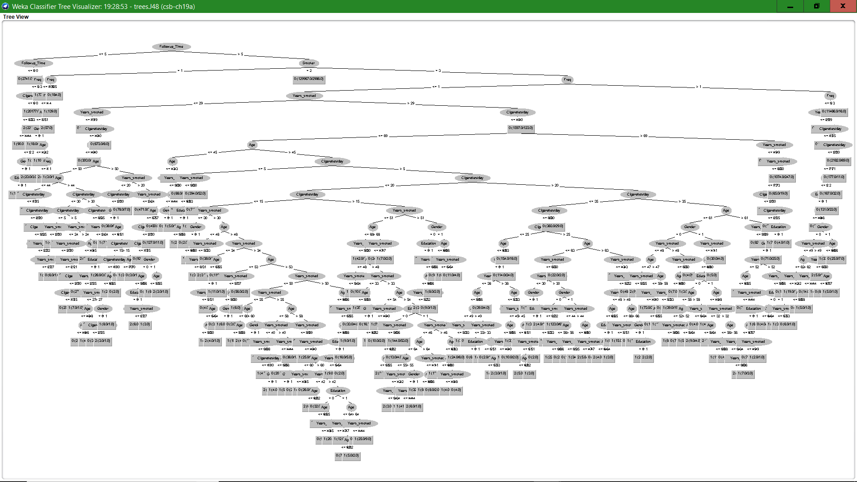
J48 Continued
Number of Leaves: 266
Size of the tree: 530

Slide 11
Analysis
Target Class 0 (0.85) - 85% alive 159,972
1 (0.12) - 12% death from other causes 22,915
2 (0.02) - 2% lung cancer death 4,222
Results could be skewed due to amount of people still alive who could have lung cancer
Cigarettes/day rounded up to the nearest 5 may be too generous
Frequency was not treated as multiple instances but instead a numeric integer
Possible applications:
Evidence for how certain attributes contribute to death by lung cancer
Whether quitting for a certain period of time reduces lung cancer or not
Each individual attribute can be analyzed with the target class of alive, dead, or death by lung cancer to see how much of an impact they cause on the target class

Slide 12
Questions?

